Slide 1

Project Activity 05 – Project Story Telling & Live Zoom Demo / Presentation
Submitted by : Syed Muhammad Ali Haidry | Wilbur Dulce | Tristan Brown-Hannibal
Student no : 200401073 | 200389437 | 200400651 |
Program : Software Systems Engineering
Presented to : Dr. Tim Maciag
Subject : ENSE 372 – Software Systems Engineering

Slide 2
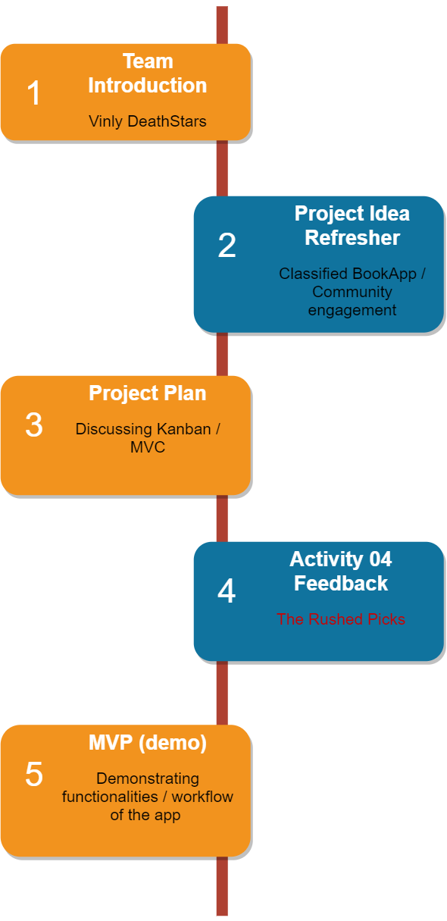


Slide 3
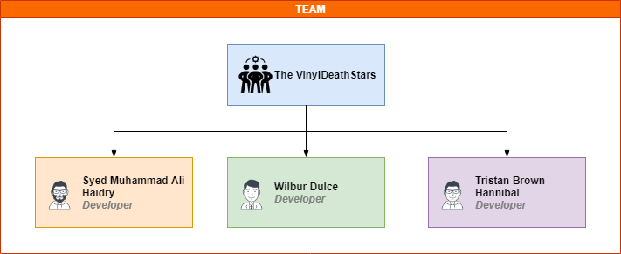
Team Introduction

Slide 4
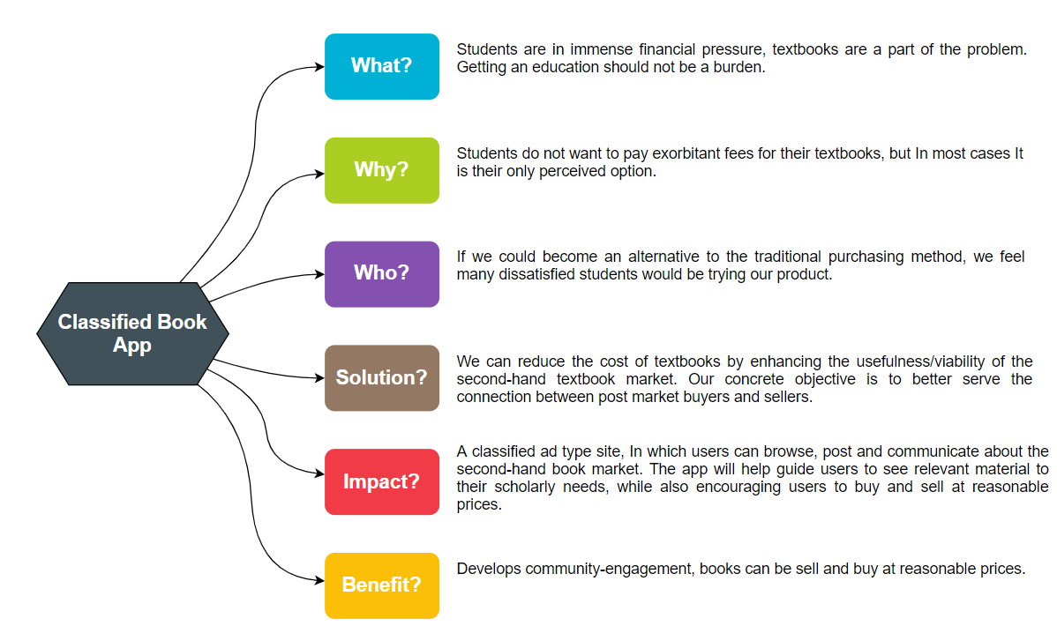

Project Idea Refresher
Reference : https://img.freepik.com/free-vector/books-engraving-vintage-open-book-engrave-sketch-drawn-hand-drawing-student-reading-textbook-illustration_102902-1291.jpg?size=626&ext=jpg&ga=GA1.2.256171563.1600387200

Slide 5
Project Plan / Documents Overview
Highlight on Kanban

Slide 6
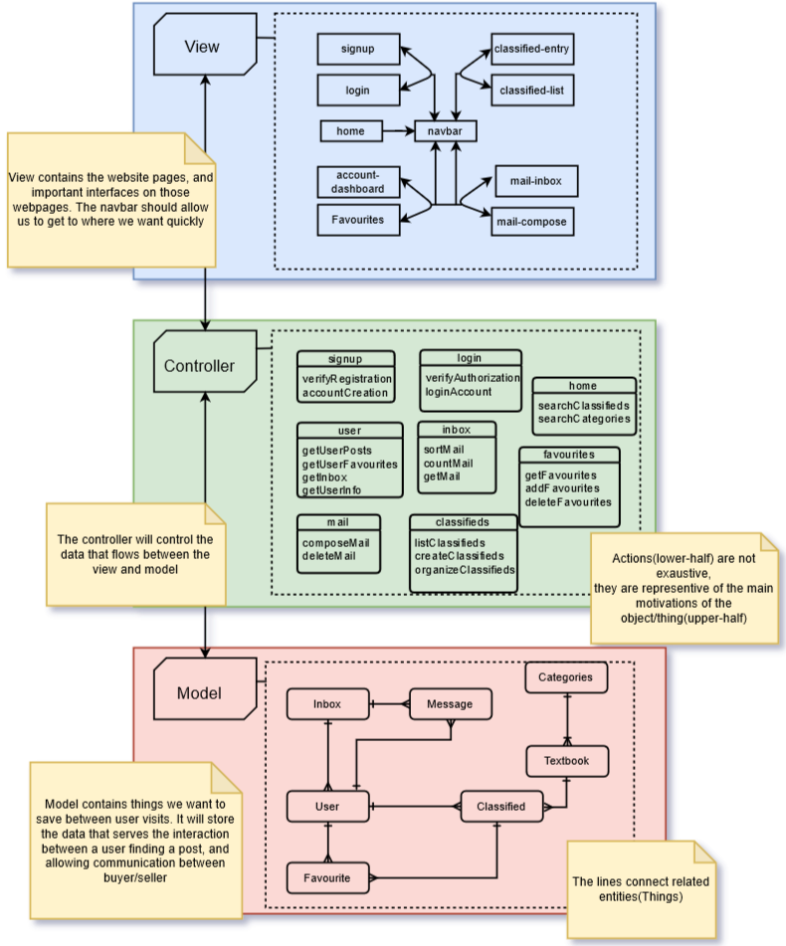

Slide 7
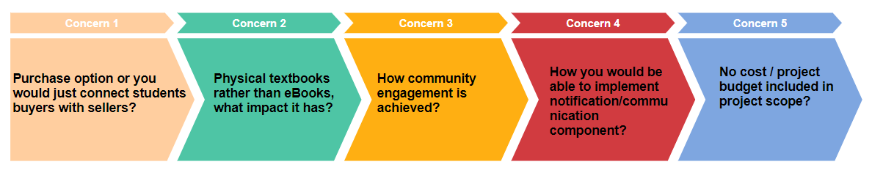
Activity 04 : Feedback by The Rushed Picks

Slide 8
MVP DEMO

Slide 9
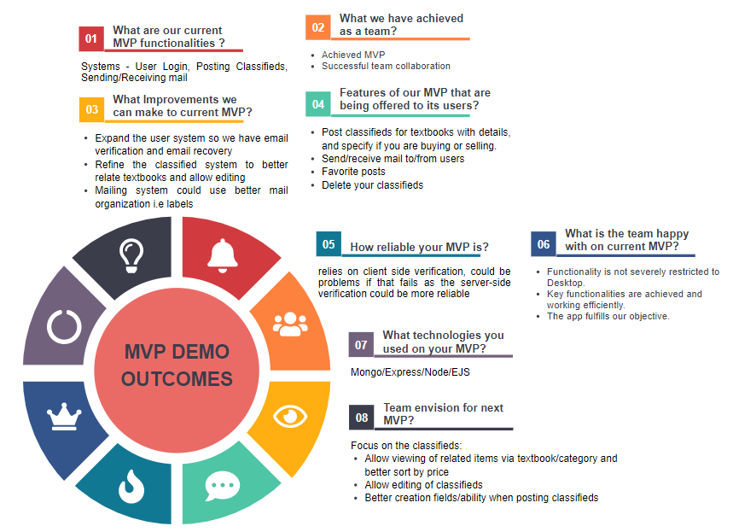
MVP Outcomes

Slide 10
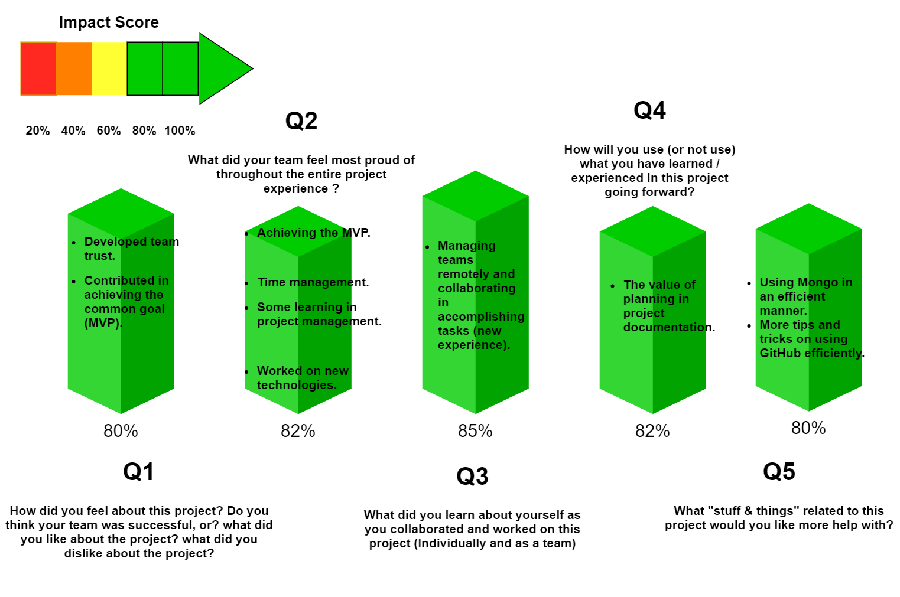
Team Reflection Discussion

Slide 11
Q&A

